Slide 1
NAS for RNN with Compression
宋玉红
2020.06.27

Slide 2
Task List
How to Prune parameters in RNN
Figure out the specifics of Attention and Transformer model
Lite Transformer

Slide 3
Task1
How to Prune parameters in RNN
CNN
RNN

Slide 4
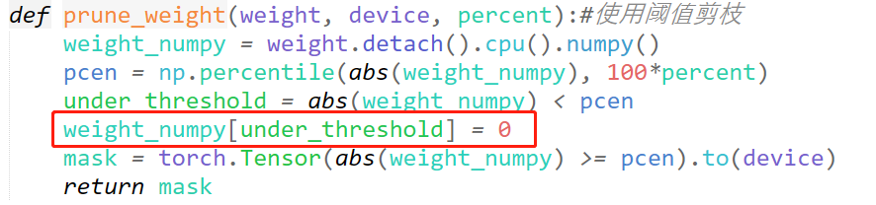
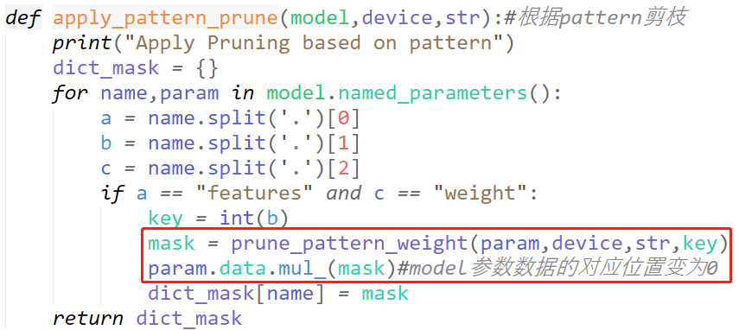
Task1
In CNN
Weight threshold
Kernel mask ----pattern

Slide 5
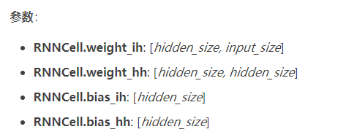
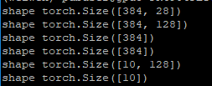
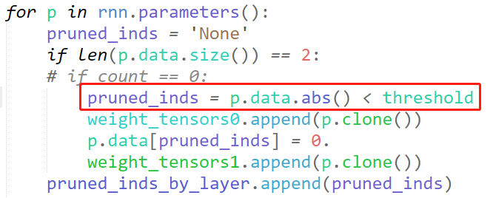
Task1
In RNN
Vanilla RNN、LSTM、GRU
Different shape of parameters
Weight threshold
GRU Cell
FC
Input size: 28
Hidden size: 128

Slide 6
Task2
Figure out the specifics of Attention and Transformer model
Attention
Transformer

Slide 7
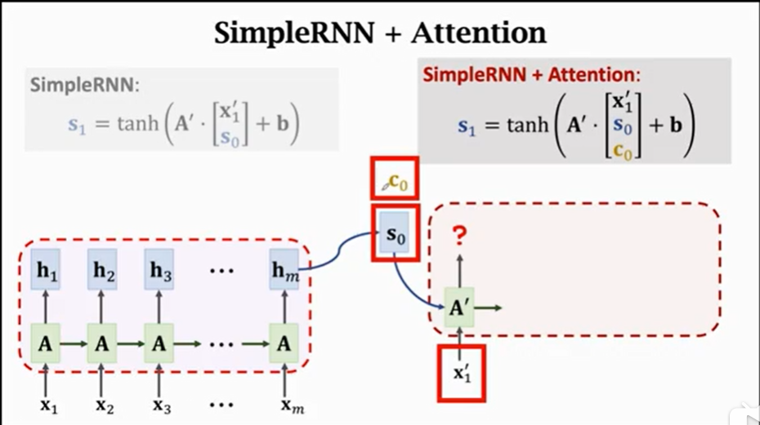
Task2
Attention with RNN(2015)
Encoder: every hidden state(h) is computed by input sequence and last hidden state
Decoder:
every hidden state(s) is computed by input sequence, last hidden state and last attention
Every attention is the weighted sum of the hidden states in Encoder, so it maintain the whole information of sequences

Slide 8
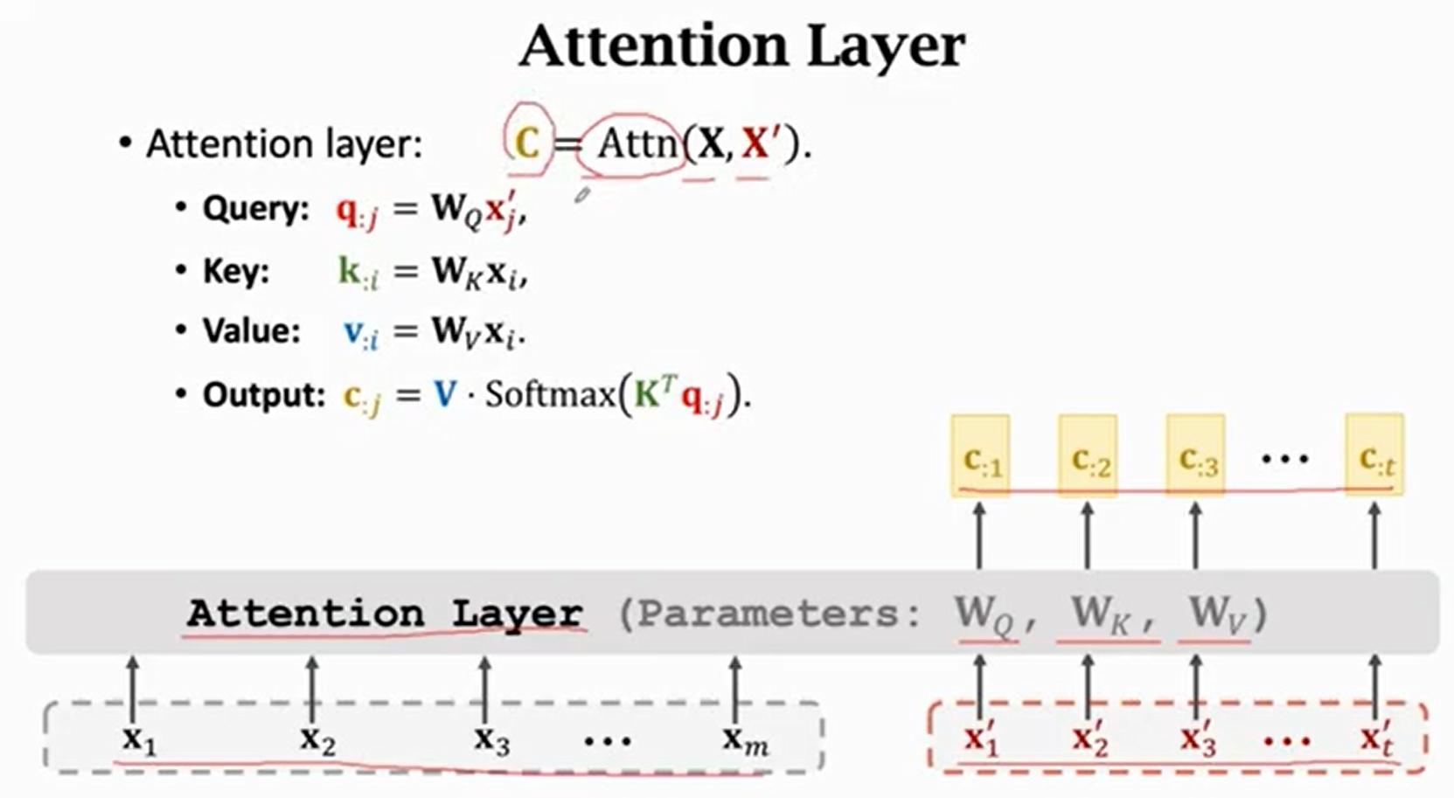
Task2
Attention is all you need(2017)

Slide 9
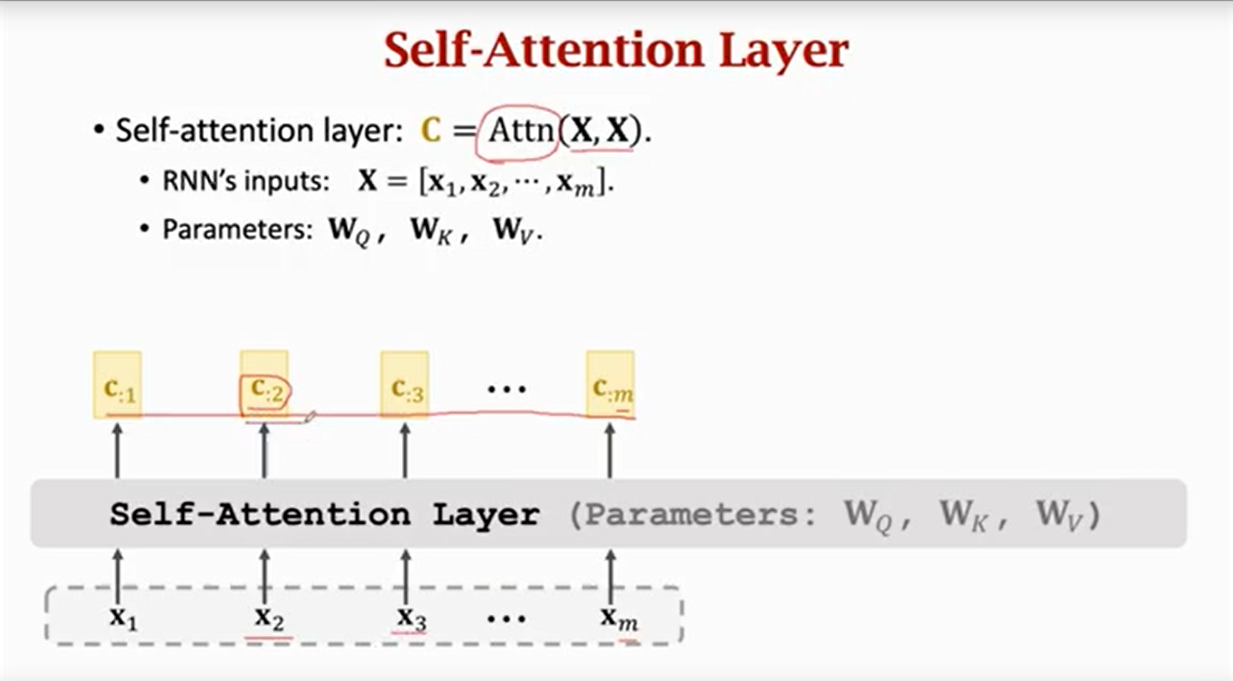
Task2
Self-Attention

Slide 10
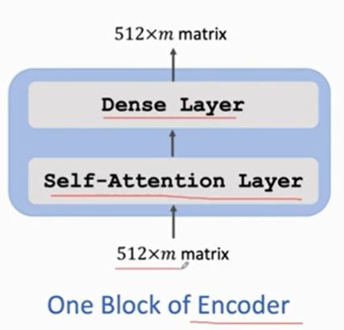
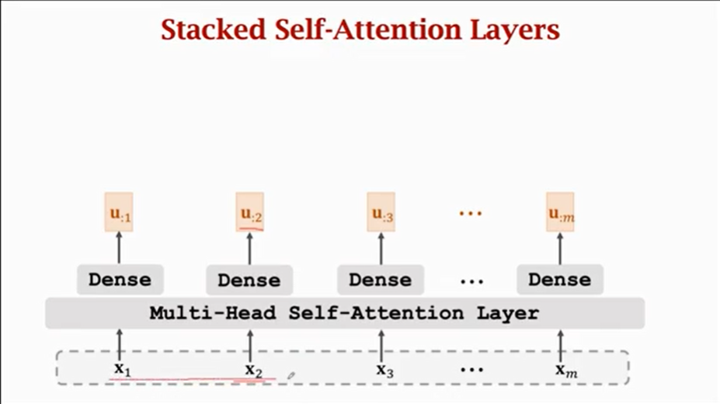
Task2
Transformer Encoder

Slide 11
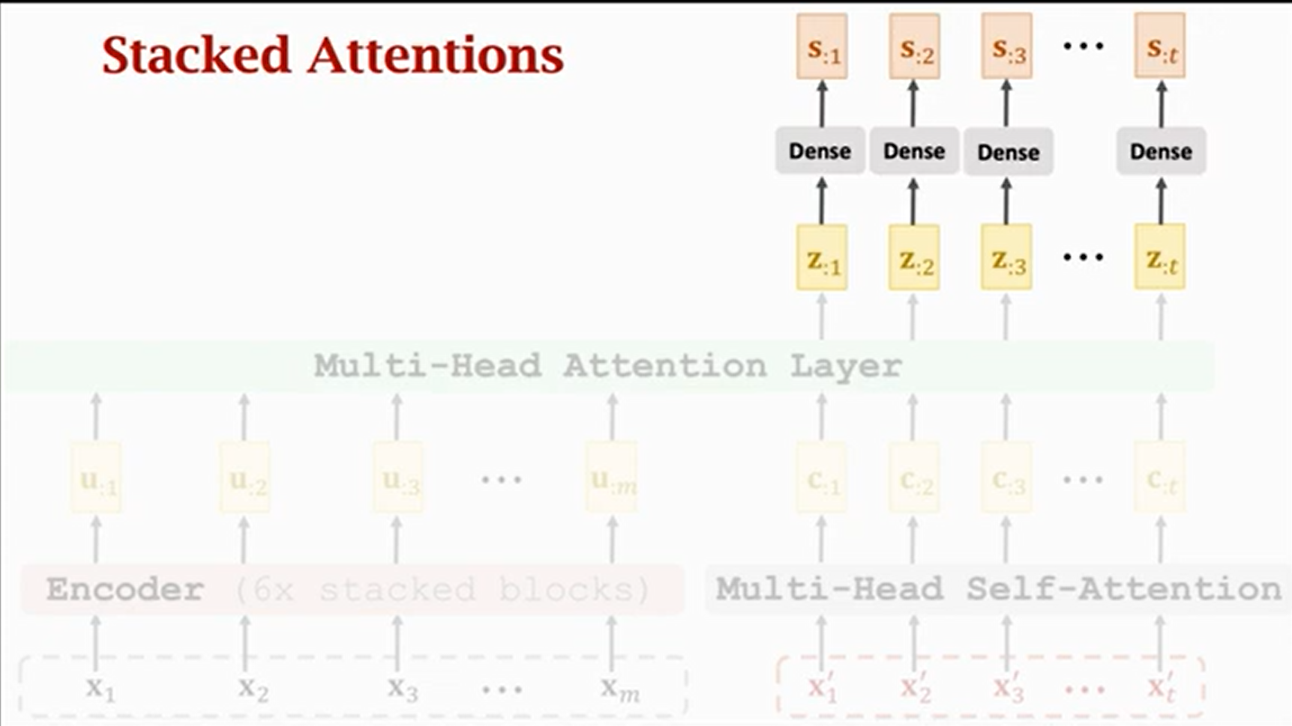
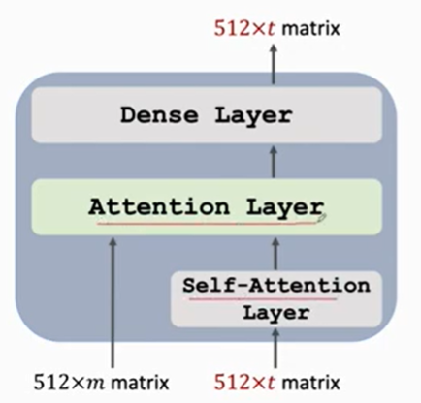
Task2
Transformer Decoder

Slide 12
Task3
Lite Transformer
Lite transformer block
NAS for transformer

Slide 13
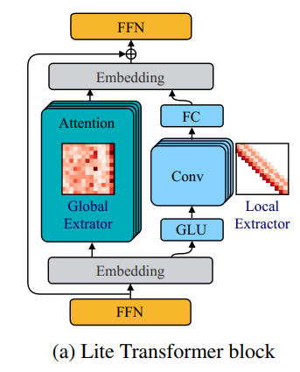
Task
Lite Transformer Block
The attention branch can focus on global context capture
Convolution in a parallel branch to capture local dependencies
Split it into two parts along the channel dimension to lighten the attention computation
Combine with pruning and quantization to further compress model

Slide 14
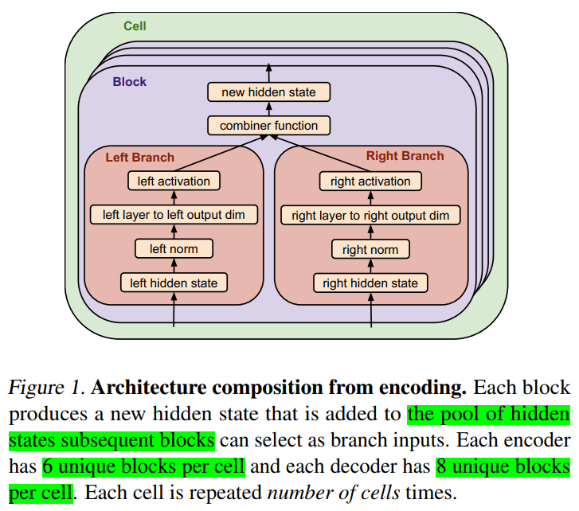
Task
NAS for Transformer
Evolution-based NAS Tournament selection
Search Space
Input
Normalization
Layer
Output dimension
Activation
Combiner
Numbers of cell
David So, Quoc Le, and Chen Liang. The Evolved Transformer. In ICML, 2019.
Notes:
Input：分支可以从输入池中选择一个隐藏状态作为当前block的输入。单元中的第i个block可以从[0, i]个隐藏状态中进行选择，其中第j个隐藏状态表示该cell中第j个block的输出，第0个候选项为单元的输入。
Normalization：归一化项提供了两个选项， [LAYER NORMALIZATION (Ba et al., 2016), NONE]
Layer：构造一个神经网络层，提供的选项包括：
标准卷积深度可分离卷积
LIGHTWEIGHT 卷积
n头注意力层
GATED LINEAR UNIT
ATTEND TO ENCODER（decoder专用）
全等无操作
Dead Branch，切断输出
Relative Output Dimension：决定神经网络层输出的维度。
Activation：搜索中激活函数的选项有[SWISH, RELU, LEAKY RELU, NON]
Combiner Function：表征的是左枝和右枝的结合方式，包括{ADDITION、CONCATENATION、MULTIPLICATION}。如果左右枝最终输出形状不同，则需要使用padding进行填充。短的向量向长的向量对齐，当使用加法进行结合时使用0填充，当使用乘法进行结合时使用1填充。
Number of cells：纵向叠加的cell的数量，搜索范围是[1,6]

